Slide 1
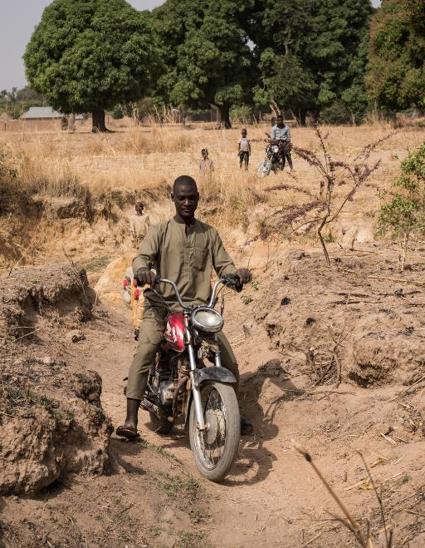
Climate change impacts
WaterAid/ Yvonne Etinosa
Learning Question:
What impacts will climate change have on the world?
Learning Objectives:
I can appraise and organise the different impacts of climate change.
I can construct a chain of impacts of climate change.

Slide 2
Odd-One-Out – Recap of the causes of climate change
TASK: From the lists find the odd-one-out and explain why you’ve chosen it.
1 | Carbon Dioxide | Methane | Nitrous Oxide | Oxygen
2 | Animals | Volcanoes | People | Plants
3 | Coal | Wind | Oil | Gas
4 | Deforestation | Eating Burgers | Using Solar Panels | Leaving lights on
5 | Aerosols | Airplanes | Cars | Power stations
Challenge: Make your own list and see if your partner can work it out!

Slide 3

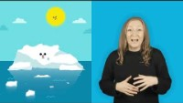
Impacts of Climate Change?
Task: Watch this video and listen for the impacts of climate change, if you can write the impacts down.
Notes:
Link: https://www.youtube.com/watch?v=ZDzTnt1Y_sE OR click the blue button in the top right hand corner to be taken to the video

Slide 4
Impacts of Climate Change
TASK: Create a spider diagram on the impacts of climate change. Use your own knowledge, information from the video and the fact sheets to help you create a detailed spider diagram. Add facts and statistics to help support your points.
Challenge: Link any connected impacts together and categorise them as environmental, economic or social.

Slide 5
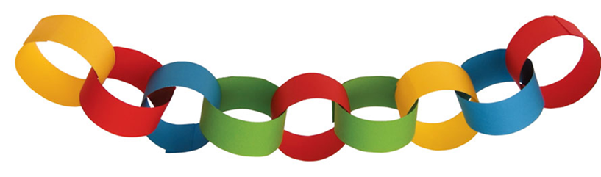
Chain of consequences
TASK: Using your list create a paper chain of consequences!
On each link of you paper chain write an impact of climate change. Start with climate change as your first link. Attach to this your next labelled impact loop. Continue adding links until you have a long paper chain of consequences. You can add as many links as possible and each link can have multiple links coming off of it.
If you finish, go back to the first link labelled climate change and start another branch to your chain!
An example chain:
Climate change
Increasing temperatures
Increased rainfall
Increased flooding
Contaminated water
Waterborne diseases

Slide 6
What will happen if our climate changes?
Think about what will happen to: Think about the whole world:
Plants? Animals? People? Places? Will some places be impacted more?
Think big or small: Think about how severe it may be:
Will this happen everywhere? Will the impact get worse over time?
How many people will it effect? Will it improve over time?
Challenge: Can you link any of the impacts together?

Slide 7
Analysing the chain of consequences
TASK: Having created your consequences paper chain we need to answer the following question:
Which impact of climate change will have the greatest effect? Why?
I think the biggest impact of climate change will be….
I think this because…
Challenge: How do you think that climate change will impact you personally in the future?
Things to think about:
Who will this impact?
How many people, animals or places will be impacted?
What are the long term consequences of this impact?

