Slide 1
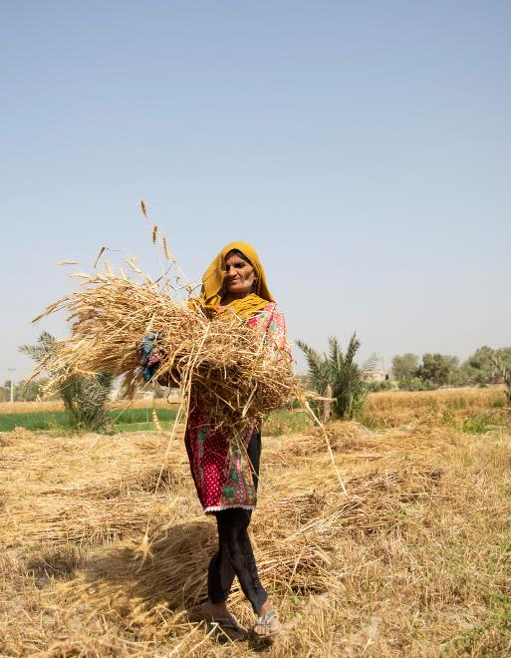
Climate change and water
WaterAid/ Saiyna Bashir
Learning Question:
What is the link between climate change and water?
Learning Objectives:
I can investigate methods for solving water access issues.
I can select and defend the best solution to solve a water access problem.

Slide 2
What have you used water for today?
Task: Write down all of the ways in which you have used directly water today.
Challenge: Make a list of the ways you have indirectly used water today?
Directly: water used straight from the tap, bottle or river.
Indirectly: water used to make or grow or run other activities.
Directly:
Cooking
Cleaning
Washing
Indirectly:
Growing foods
Dyeing clothes
Cooling down machines

Slide 3

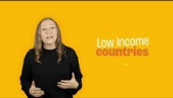
Managing Climate Change
Task: Watch this video and listen for ways we can mange the impacts climate change on water.
Notes:
Link: https://youtu.be/rpqtEe8BGQg OR click the blue button in the top right hand corner to be taken to the video

Slide 4
How are water and climate change linked?
Climate change will impact upon our water supplies in a number of ways:
Increased rainfall, extreme weather and rising sea levels will lead to flooding. Flooding pollutes water sources and surrounding areas, including homes and crops, with sewage and waste.
Decreased rainfall and higher temperatures will lead to drought. Drought reduces the amount of clean water in dry areas leaving people, animals and landscapes with no water.
As climate change worsens the number of people without access to safe water will increase.

Slide 5
How can we defend ourselves?
Climate change is a serious risk to everyone, everywhere having clean water, decent sanitation and good hygiene (WASH).
It threatens to reverse progress in improving access to these essentials, and push more people into extreme poverty.
Our best defence against the effects on water from climate change is to use robust systems, and to work with local communities to ensure they have the tools and training needed to maintain them.

Slide 6
Solving the problem:
Task: There are 3 locations which need a solution to their access to clean water because of climate change. Read through the locations problems and its characteristics and try to find a solution.
Location 1: Dengeza, Ethiopia
Location 2: Paikgachha, Bangladesh
Location 3: Sablogo, Burkina Faso
Try to decide on your top two solutions for the location from the the information you have been given.
Step 1: Assessing the situation
Step 2: Finding a solution

Slide 7
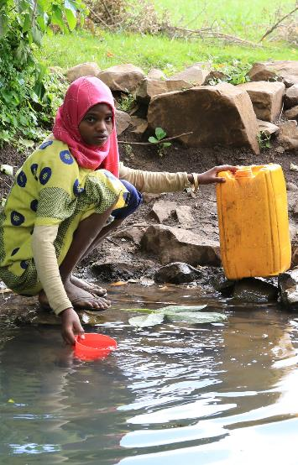
Location 1: Dengeza, Ethiopia
Zahra lives in the village of Dengeza in the hilly and mountainous region of Ethiopia.
In order to collect clean drinking water she must walk for 2 hours up the hills to collect water from a spring.
This water is precious and so only used for drinking and cooking. To wash they must use the nearby river which has unsafe water.
Flooding due to climate change is an issue and it contaminates their clean water spring. In summer droughts make the spring stagnant leading to sickness.
Dengeza:
Village residents live close together.
The village is in a hilly area.
The ground is not hard rock but there are forests.
The village receives rainfall in the wet season and can suffer flooding.
Project is government and community funded.
The community hopes to help with installation.
WaterAid/ Behailu Shiferaw

Slide 8
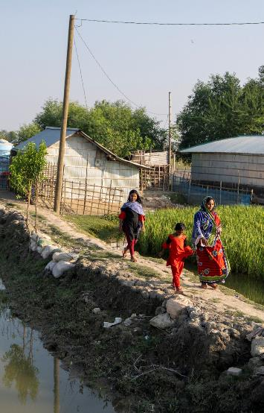
Location 2: Paikgachha, Bangladesh
Sabina lives in the village of Paikgachha next to a river that regularly floods and is becoming increasingly salty due to climate change.
The increasing sea levels due to climate change are increasing the saltiness of the water which means that the river water they use has become unusable for daily tasks.
This is forcing residents to walk long distances to collect water or pay high prices to get water delivered to their houses.
Paikgachha:
Residents in the village are spread out.
The village is low lying and can suffer flooding.
The ground is not hard rock.
The village receives plenty of rainfall.
The project will be supported through charitable funds.
Residents have low-incomes.
WaterAid/ Habibul Haque

Slide 9
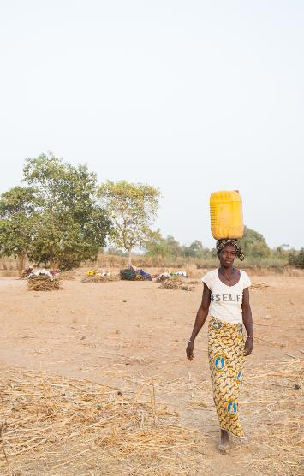
Location 3: Sablogo, Burkina Faso
Evelyne lives in Sablogo where she is relies on unsafe river water.
A lack of clean water points in Sablogo means she is forced to collect unsafe water from the river. This means her family is often ill misses work and school.
Climate change is drying the riverbed out as rains fail and droughts hit the region. This leaves the village without safe water to drink or use on their crops.
Sablogo:
Has funding from the government and will be supported maintenance.
Is built on hard rock and flat land.
Suffers from long droughts
Has groundwater sources 120m deep.
Needs to supply the entire village and their crops.
Has very low-income residents.
Residents in the village live close together.
WaterAid/ Basile Ouedraogo

Slide 10
Explaining the solution:
Task: For your location write a proposal for WaterAid to explain what solution you think will best fit the communities needs. Explain why it is the best solution and why it is better than the alternatives.
You could structure it as follows:
Summary of their situation and what they need
Give your recommendation and explain what it is
Explain why you have chosen that solution over the others
Explain why you have decided not to use the other solutions
Challenge: Can you think of any other climate change management techniques that might be appropriate in your location?

Slide 11
What did WaterAid do to help?
These three communities are real life examples. WaterAid completed the same tasks that you have done and helped a community choose a solution to their water access issues.
Dengeza
Paikgachha
Sablogo

Slide 12
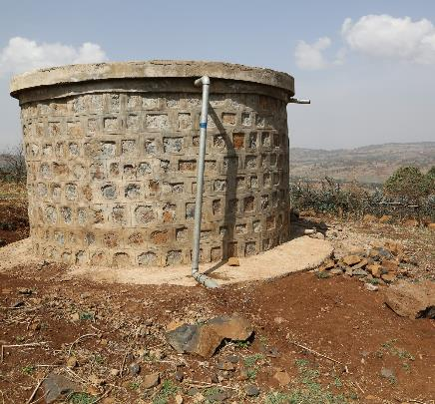
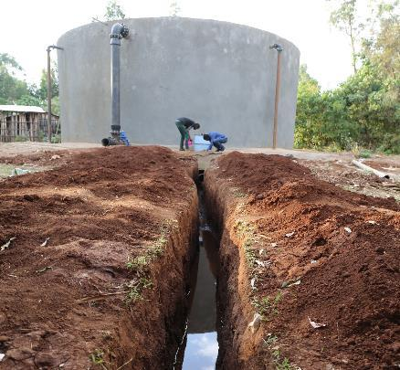
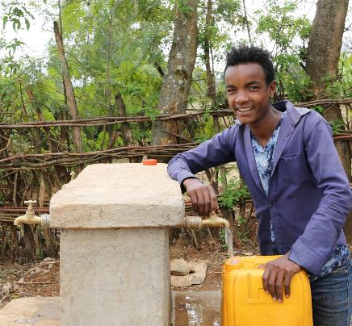
Location 1: Dengeza, Ethiopia - Solution
Dengeza struggles because the closest safe drinking water was far away, up hill and suffered from flooding. To help in areas like this WaterAid Ethiopia has installed gravity fed systems to allow water to be piped closer to the local communities and protected the springs from contamination.
WaterAid/ Behailu Shiferaw

Slide 13
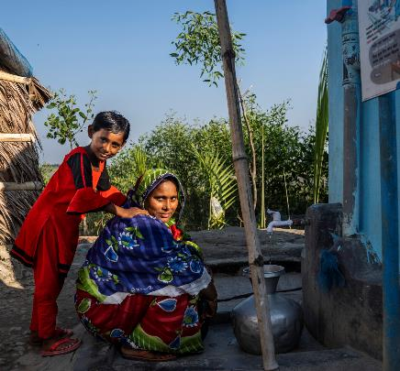
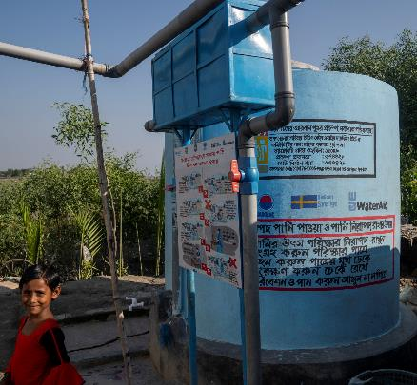
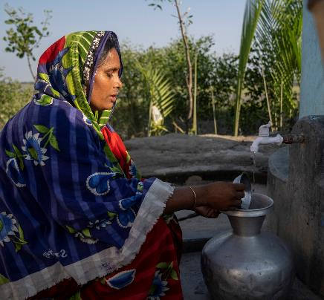
Location 2: Paikgachha, Bangladesh - Solution
Paikgachha struggled with flooding from river and an increasing salinity (saltiness) to the water. To help WaterAid Bangladesh installed rainwater harvesting systems for the families along the river. Sabina and her family no longer need to rely on buying or fetching water.
WaterAid/ Habibul Haque

Slide 14
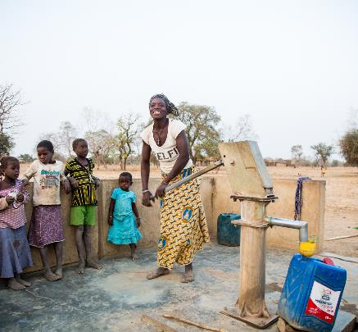
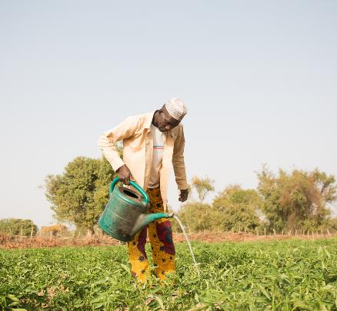
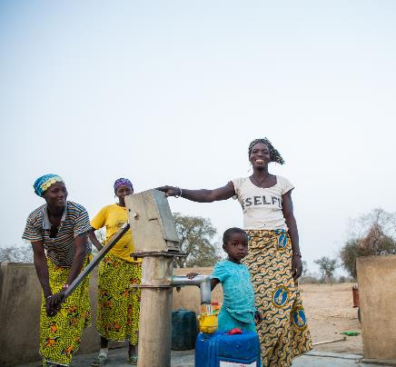
Location 3: Sablogo, Burkina Faso - Solution
Sablogo struggles with droughts as climate change causes rains to fail this leads people to rely on river water. To help the situation WaterAid West Africa has dug a borehole and pumps to provide clean water. As a result the community sees less illnesses, is able to drink safe water and water their crops.
WaterAid/ Basile Ouedraogo

