Slide 1
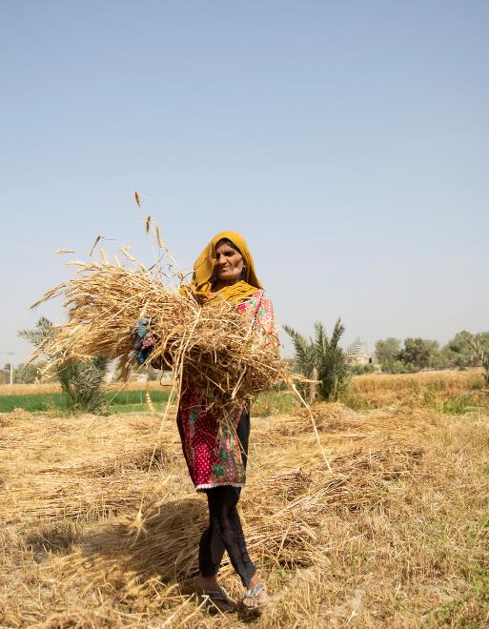
Managing climate change
WaterAid/ Saiyna Bashir
Learning Question:
How can we deal with the changes caused by climate change?
Learning Objectives:
I can interpret the methods of managing climate change.
I can critique the best methods for managing climate change.

Slide 2


Managing Climate Change
Task: Watch this video and listen for ways we can mange climate change.
If you can, write them down.
Notes:
Link: https://youtu.be/qpchgGUDS7Y OR click the blue button in the top right hand corner to be taken to the video

Slide 3
Managing the impacts of climate change
There are two ways of managing the impacts of climate change:
Mitigation:
the action of reducing the severity, seriousness, or painfulness of something.
How can we mitigate climate change?
Reducing the amount of greenhouse gases released
Adaptation:
the act or process of changing to better suit a situation.
How can we adapt to the effects of climate change?
Helping people to live with the effect of climate change.

Slide 4
Managing the Impacts of Climate Change
TASK: You are going to summarise the information cards in pictures.
Read the information sheet and summarise each method for managing climate change by drawing pictures. You are only allowed to write down 5 words in each box.
You will have 4 minutes with each sheet before swapping for a new one.
Once you have finished drawing ALL of the pictures you can summarise the impacts in a short paragraph.

Slide 5
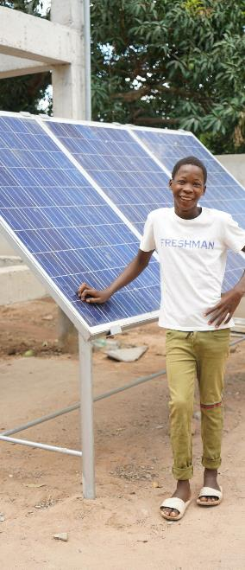
Mitigation: Renewable energy
To reduce the amount of CO₂ in the air renewable energy can be used and promoted as an alternative to fossil-fuels. This can be done by:
Investing in building and installing renewable energy sources such as wind or solar farms.
Promote and establish schemes or grants for installing wind turbines or solar panels on private residences, farms and other community spaces.
Introduce a CO₂ emissions tax or a fuel tax to encourage companies and people to invest in renewable energy sources and to help pay for climate change related issues.
WaterAid/ Ernest WaterAid/ Chileshe Chanada

Slide 6

Mitigation: Conserve energy and reduce wastage
To reduce the amount of CO₂ in the air energy should be used more efficiently and wasted less. This can be done by:
Promoting industrial energy efficiency by taxing emissions and providing funding to those seeking to improve.
Improving transport to avoid congestion and encourage use of public transport such as trains, trams and buses.
Improve building regulations to ensure more sustainable buildings that are properly insulated and more energy efficient.
Promote and raise awareness of energy saving practices such as recycling and using efficient light bulbs and household appliances.
Introduce laws ensuring all new appliances are energy efficient
WaterAid/ Ernest WaterAid/ Sibtain Haider

Slide 7
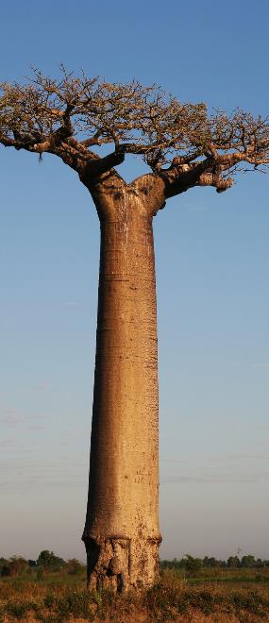
Mitigation: Carbon capture and afforestation
To reduce the amount of CO₂ in the air the use of methods for removing atmospheric CO₂ should be increased. This can be done by:
Using carbon capture to store CO₂ under the ground. Carbon capture is a method of catching up to 90% of CO₂ produced in industrial processes, compressing it and transporting it via pipes to an injection well that turns the CO₂ to liquid and stores it underground.
Trees both store and remove CO₂ from the atmosphere through photosynthesis. Trees can also help with the impacts of climate change by preventing flooding, reducing city temperatures and keeping soils nutrient rich and fertile. This is the cheapest and most effective method of combating climate change as each tree can annually absorb between 10-40kg of CO_{2.}
WaterAid/ Ernest WaterAid/ Ernest Randriarimalala

Slide 8
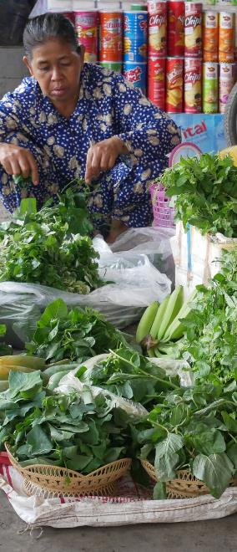
Mitigation: Locally sourcing goods and food
To reduce the amount of CO₂ in the air products should be sourced from local sources reducing transport emissions. This can be done by:
Promoting locally sourced good and food to the public encouraging them to buy and reduce the “miles” their food is transported and therefore their carbon footprint.
Provide incentives to businesses to use and sell more locally sourced products rather than internationally sourced goods.
Encourage the farming of crops locally that grow well in our climate but have high import rates from overseas.
Tax imports from other countries to discourage businesses from importing foreign goods. Subsidising or offering lower taxes on local good and foods may discourage foreign imports.
WaterAid/ Ernest WaterAid/ Sok Sineath

Slide 9

Mitigation: International cooperation
To reduce the amount of CO₂ in the air countries could cooperate and support each other in reducing their emissions. This can be done by:
Supporting developing countries in their efforts to reduce emissions through technological and economical support.
Holding countries accountable for not reaching targets for emission reductions.
Rewarding countries that reach targets for emissions reductions.
WaterAid/ Ernest WaterAid/ Anna France-Williams

Slide 10

Adaptation: Change agricultural practices
Climate change will impact both the food we grow and the way we grow it. The government and farmers could adapt by:
Alter the species they farm to suit the new climate conditions, for example growing oranges instead of wheat. Alternatively altering the growing seasons or locations of crops. Southern Britain is an increasingly great location for vineyards.
Use Genetically Modified crops that cope difficult conditions. For example, drought tolerant wheat (SeriM82) has deep root systems to help access more water.
Invest in water harvesting technology (dams and reservoirs) to conserve soil moisture during decreased rainfall.
Invest in drainage technology to drain water and prevent water logging, erosion, and nutrient leaching during increased rainfall.
Improve pest, disease, and weed control to prevent spreading due to the changing climate.
Use climate forecasting technology to reduce production risk.
WaterAid/ Saiyna Bashir

Slide 11
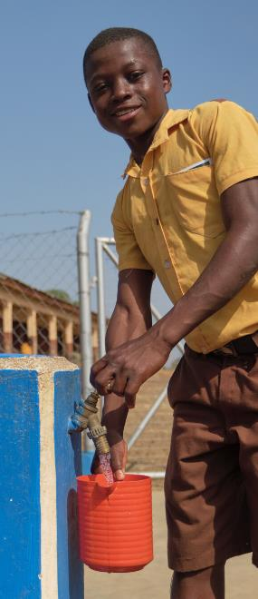
Adaptation: Managing water supplies
Climate change will impact the quantity and quality of water supplies globally. Governments and communities can:
Reduce wasted water by educating individuals on efficient water usage and regularly maintaining water systems to reduce leaks.
Invest in groundwater technologies (such as boreholes and solar pumps) which can provide safer more reliable water than the surface, particular where droughts and flooding occur.
Invest in rainwater harvesting and storage facilities so that water can be safely stored ready for drier periods of time.
Raise water points and latrines above flood levels to prevent cross-contamination during flooding.
Introduce technology to clean unsafe water (filters or desalinisation)
Invest in water transfer schemes, where water is stored in one location (reservoir) and transferred via pipes to where it is needed.
WaterAid/ Ernest WaterAid/ Apag Annankra

Slide 12

Adaptation: Reduce risk from sea level rise
Climate change will raise sea levels impacting coasts through erosion, loss of habitats and infrastructure. Communities can adapt by:
Abandon: Abandon or retreat from areas that are high risk but are not worth saving economically or socially. This is the only solution that eliminates potential future damages.
Plan: Plan a managed retreat to allow for coastal adaptation long term. Retreating from an area and developing a coastal ecosystem (e.g. saltmarsh or mangroves) that acts as a buffer between us and the sea.
Engineer: Engineer new defences to protect the coast from erosion. These rely on assuming the height of sea level rise.
  Hard engineering options include building seawalls, levees or rebuilding homes onto stilts to protect from the sea.
  Soft engineering options include developing sand dunes, or raising island height to create natural barriers between the sea and people.
WaterAid/ Ernest WaterAid/ Nyani Quarmyne

Slide 13
Climate Change Responses Game
Task: Play the game to find out about managing climate change.
Aim:
The aim is to be the player with the highest environmental score and the lowest economic score at the end of the game.
Rules:
Everyone starts with 25 economic and 25 environment points.
Use your sheet to make a note when something happens, keep track of your economic and environment points (they can be + or -).
Continue playing until your are told to stop.
The shortest player will go first. Play to your right, roll the dice and follow the instructions.

Slide 14
Event Card
Action Card
Action Card
Event Card
Action Card
Event Card
Action Card
Action Card
Event Card
Action Card
Event Card
Action Card
Action Card
Event Card
Action
Card
Event Card
BACK TO START
Action Card
Action Card
Event Card
Event Card
Action Card
Event Card
Event Card
Action Card
Action Card
Event Card
Action Card
Event Card
Action Card
Action Card
Event Card
Action Card
Start

Slide 15
Climate Change Responses
Task: Answer the following questions, use examples to support your points and explain why.
Which responses were good for the environment? Why?
Which responses had a high economic cost? Why?
Which responses seem to be the easiest to do? Why?
Which responses are the most effective against climate change? Why?
In your opinion, is it better to mitigate or adapt to climate change?
Challenge: Why is responding to climate change complex for governments?

